Slide 1
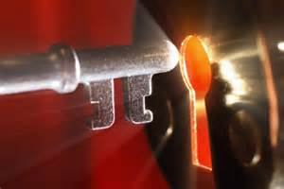
Six Secrets
of the
Christian Life

Slide 2
Introduction

Slide 3
Question ?
How does the Christian live the Christian life?

Slide 4
Secret #1
The Miracle
of Resurrection

Slide 5
The Problem
Believe
Eternal Life
Christ in you
New Life
Dead Body

Slide 6
The Solution
Believe
New Life
Dead Body
Righteousness
His Spirit
How?
Life

Slide 7
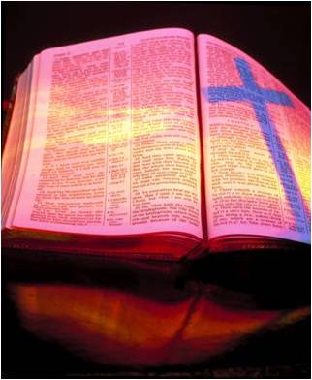
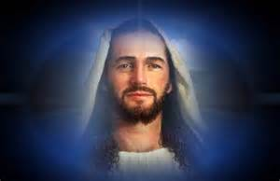
The Solution
Continuous Faith
Unveiled Face
Dead Body
His Power
Transformation
Process

Slide 8
The Solution
Continuous Faith
Unveiled Face
Life
His Power
Transformation
Process

Slide 9
Secret #2
The Miracle
of Transformation

Slide 10
Seeing What We Are
God’s Mirror, the Word, offers us a “double image”.

Slide 11
Living in the Light
James 1:22-24

Slide 12
Seeing What We Are
“But be doers of the word, and not hearers only, deceiving yourselves. For if anyone is a hearer of the word and not a doer…”

Slide 13
Seeing What We Are
“he is like a man observing his natural face in a mirror; for he observes himself, goes away, and immediately forgets what kind of man he was.” (James 1:22-24)

Slide 14
Seeing What We Are
“he is like a man observing his natural face in a mirror;” (James 1:23b)

Slide 15
Seeing What We Are
“natural” is “genéseos”
“beginning”
“origin”
“birth”

Slide 16
Seeing What We Are
“he is like a man observing the face of his birth in a mirror;” (James 1:23b)

Slide 17
Seeing What We Are
“Every good gift and every perfect gift is from above, and comes down from the Father of lights,” (James 1:17a)

Slide 18
Seeing What We Are
Heavenly Father
Supremely Perfect Gift
The Gift of Spiritual Birth

Slide 19
Seeing What We Are
“Of His own will He brought us forth by the word of truth, that we might be a kind of firstfruits of His creatures.” (James 1:18)

Slide 20
Seeing What We Are
“brought forth” means
“to give birth”
“to bear”

Slide 21
Seeing What We Are
“having been born again, not of corruptible seed but incorruptible, through the word of God which lives and abides forever,” (1 Peter 1:23-24)

Slide 22
Seeing What We Are
“…He brought us forth by the word of truth…” (James 1:18)
“having been born again… through the word of God…” (1 Peter 1:23-24)

Slide 23
Seeing What We Are
His Instrument
Hearing
Believing
John 3:16
5:24; 6:47
“born again”

Slide 24
Seeing What We Are
Continuous Faith
Dead Body
His Power
Transformation
Process

Slide 25
Seeing What We Are
Continuous Faith
Life
His Power
Transformation
Process

Slide 26
Seeing What We Are
New Life
Renewed Life

Slide 27
Seeing What We Are
Believe
Inwardly a
New Person,
New Nature
Dead Body

Slide 28
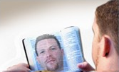
Seeing What We Are
New Person
We see what we truly are

Slide 29
Seeing What We Are
Conformed to His Image
New Person
We see
Ourselves
and LJC

Slide 30
Seeing What We Are
New Person
Physical Body
New Self,
Without Sin
Evil Within;
Nothing Good Dwells

Slide 31
Seeing What We Are
“I have been crucified with Christ; it is no longer I who live, but Christ lives in me…” (Galatians 2:20a)
“the life that Christ lives in us – “can only be sinless”

Slide 32
Seeing What We Are
“We know that whoever is born of God does not sin; but he who has been born of God keeps himself, and the wicked one does not touch him.”(1 John 5:18)

Slide 33
Seeing What We Are
New Person
Physical Body
True Self
Slave to God
Obedience
The Flesh
Slave to Sin
Disobedience

Slide 34
Seeing What We Are
Conformed to His Image
New Person
We see
Ourselves
and LJC
No Sin

Slide 35
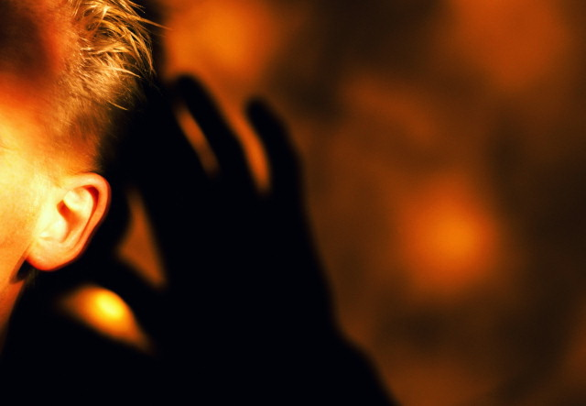
Seeing What We Are
“But be doers of the word, and not hearers only, deceiving yourselves. (James 1:22)

Slide 36
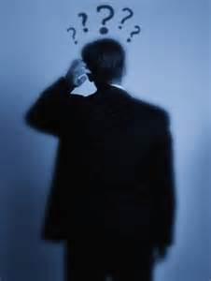
Seeing What We Are
“For if anyone is a hearer of the word and not a doer, he is like a man observing his natural face in a mirror; for he observes himself, goes away, and immediately forgets what kind of man he was.” . (James 1:23-24)

Slide 37
Seeing What We Are
Obedient Hearer
Forgetful Hearer
Hearer and Doer
Hearer Only

Slide 38
Seeing What We Are
Doer
Obedient Hearer
Law of Liberty
Delights in the Commands

Slide 39
Seeing What We Are
“But he who looks into the perfect law of liberty and continues in it, and is not a forgetful hearer but a doer of the work, this one will be blessed in what he does.” (James 1:25)

Slide 40
Seeing What We Are
Doer
Obedient Hearer
Spirit is Liberty
Delights in the Commands

Slide 41
Seeing What We Are
“For this is the love of God, that we keep His commandments. And His commandments are not burdensome.” (1 John 5:3)
“burden” -- Obligation

Slide 42
Seeing What We Are
A intensely desire to keep the Word of God because I…
“have to” -- Obligation
“get to” -- Liberty

Slide 43
Seeing What We Are
Legalism
Obedient Hearer
Obligation
Delights in the Commands

Slide 44
Seeing What We Are
Cheerful Doer
Obedient Hearer
Law of Liberty
Delights in the Commands

Slide 45
Secret #3
Coming to be in experience what we are already in our innermost being

Slide 46
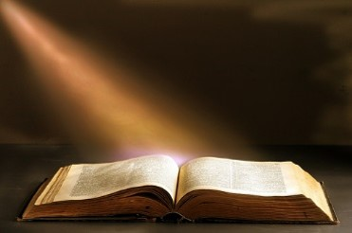
Living in the Light
Live in the light of the truth of the Scriptures

Slide 47
Living in the Light
1 John 1:6-7

Slide 48
Living in the Light
“If we say that we have fellowship with Him, and walk in darkness, we lie and do not practice the truth.

Slide 49
Living in the Light
“But if we walk in the light as He is in the light, we have fellowship with one another, and the blood of Jesus Christ His Son cleanses us from all sin.”

Slide 50
Living in the Light
“If we say that we have fellowship with Him,” (1:6a)

Slide 51
Living in the Light
“fellowship” - “koinonia”
“Sharing”

Slide 52
Living in the Light
In the Light
In the Dark
Sharing
Not Sharing

Slide 53
Living in the Light
? Question ?
How can a perfectly holy God have fellowship with us?

Slide 54
Living in the Light
Answer
Imputed Righteousness

Slide 55
Living in the Light
“If we say that we have no sin, we deceive ourselves and the truth is not in us… we make Him [God] a liar.” (1 John 1:8, 10b)

Slide 56
Living in the Light
Sin Remains Experientially
If We Walk in Darkness
No Fellowship

Slide 57
Living in the Light
? Question ?
How can a perfectly holy God have fellowship with us when we still have sin?

Slide 58
Living in the Light
“But if we walk in the light as He is in the light, we have fellowship with one another,

Slide 59
Living in the Light
“But if we walk in the light as He is in the light, we have fellowship with one another, and the blood of Jesus Christ His Son cleanses us from all sin.”

Slide 60
Living in the Light
“the blood”
The Basis of Eternal Life
The Basis of Our Fellowship

Slide 61
Living in the Light
Sin is Removed
If We Walk in Light
Fellowship

Slide 62
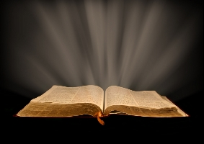
Living in the Light
The Light
Fellowship
Exposes Sin
Forgiveness
Confession

Slide 63
Living in the Light
“If we confess our sins, He is faithful and just to forgive us our sins and to cleanse us from all unrighteousness.” (1 John 1:9)

Slide 64
Living in the Light
Context of 1 John 5:-10
Stresses the Importance of Honesty and of Facing Reality

Slide 65
Living in the Light
“confession of sin”
“is to say the same thing God says about sin”

Slide 66
Living in the Light
Openness to God
Self-perception
Self-judgment
Fellowship with God

Slide 67
Living in the Light
Fundamentals
“the glory of the Lord”
“the face of our spiritual birth
“the presence of sin in our lives”

Slide 68
Living in the Light
The Light
Walk in Darkness
Fellowship
No Exposure
Forgiveness
Denial of sin

Slide 69
Living in the Light
The Light
Fundamental Christian Habit
Growth in Grace

Slide 70
Secret #4
Living with Our Hearts Open to God’s Truth

